Slide 2
Sport Development – Vision, Mandate & Objectives
Vision:
Quality sport for all people in the Royal Bafokeng region.
Mandate:
To develop sustainable sporting structures that deliver a Bafokeng community of healthy, active people while maximising their potential.
Objectives:
Encourage participation of children and adults in sport (PE & after-school/village programmes).
Identify and develop sporting talent.
Recruit and develop coaching staff.

Slide 3
RBS Development Policy
Every child has the opportunity to participate in Physical Education and after school sports within the school environment.
Continue to grow the numbers participating in all sports year on year.
Provide a pathway for children to reach their sporting potential, at local, intermediate or elite level.
Quality Management and Delivery at all Levels

Slide 4
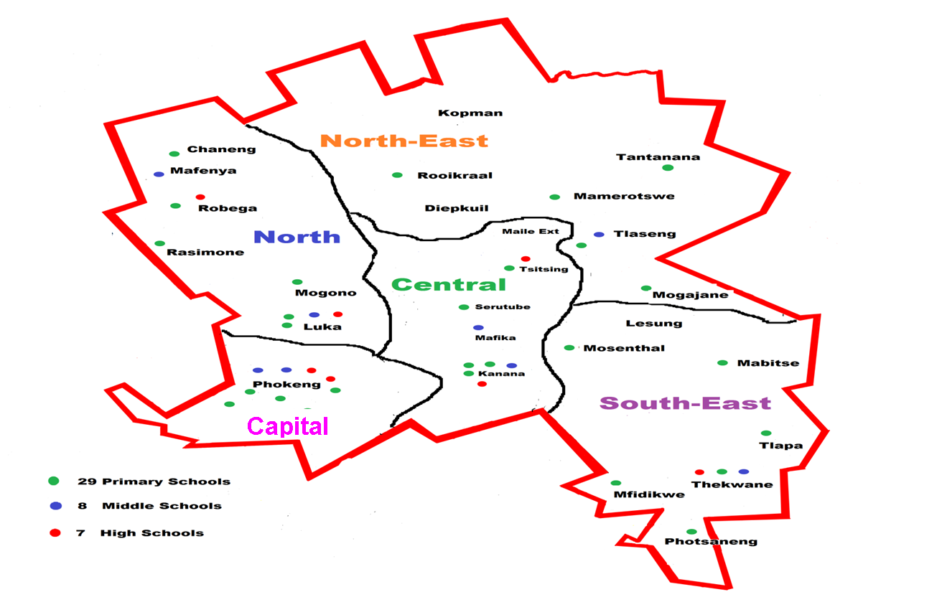
Target Market
5 Regions
29 Villages (Senior & u19 Teams)
29 Primary Schools (12,000)
9 Middle Schools (4,500)
6 High Schools (4,000)
Lebone II School (300)

Slide 5
What are we Offering?
Schools – Sam Hodson
Physical Education (PE) (Mass)
After-School Sport (Mass)
School Teams(Logistics, Coaching, Selection)
Five Sporting Codes (incl. Basketball)
Transfer of Coaching Skills
Continuous Assessment
Villages/Elite – Ezzy Seabelo
Structuring of Senior Teams
Affiliations
Transfer of Skills
School Competition (Coordination)
Regional & National Competition
Bafokeng representative teams in six sporting codes (incl. Basketball).

Slide 6
Development Pathway
Bafokeng
Representative
Teams
(Codes*)
U19
U16
U13
Platinum Stars/Platinum Leopards
Federations
Nat./Provincial
Representative
Teams
(Codes*)
U19
U16
U13
Vodacom/Sasol/Crocodiles/Platinum Athletics/Netball /Karate /(Basketball)
Senior & u19 Teams (Village)
School Teams (Intermediate) (Codes*)
U13, U16, U19.
After School Sports (Mass)
Physical Education (Mass)
*Age Groups may differ per code.

Slide 7
Responsibilities
Managing Director George Khunou
Director: Sport in Schools
Sam Hodson
Consult, Evaluate & Report
Ronnie Carroll
Director: Intermediate & Elite Sport
Ezzy Seabelo
PE & After-School (Mass)
Curriculum & Implementation
Sports Timetable
Staffing
Elite (Bafokeng Representative Teams) (6 codes)
Staffing & Training
Talent Identification
Affiliations and Competitions
After-School (Mass)
Sports Timetable
Staffing
Senior Clubs
Structuring and management ass.
Talent Identification
School Team Preparation
Coach Selection
Team Selection & Training
Team Logistics
Inter-Schools, Regional & National
Competitions
Competition & Venue Scheduling
Admin (refs, league tables, etc)
Provincial & National Competitions
Federation Affiliation
Continuous Assessment & Transfer of Skills

Slide 8
Schools Sports
Director: Sport in Schools
Sam Hodson
P A to Director: Sports in Schools
Regional Manager
North Region
Regional Manager
North East Region
Regional Manager
Central Region
Regional Manager
South East Region
Regional Manager
Capital Region
School Sports
Coordinators 13
(Primary Schools 6)
(Middle/High Schools 5)
School Sports
Coordinators 9
(Primary Schools 5)
(Middle/High Schools 1)
School Sports
Coordinators 12
(Primary Schools 5)
Middle/High Schools 4)
School Sports
Coordinators 9
(Primary Schools 6)
(Middle/High Schools 2)
School Sports
Coordinators 14
(Primary Schools 7)
(Middle/High Schools 3)
Teacher Coaches
11 x 5 = 55
Teacher-Coaches
6 x5 = 30
Teacher-Coaches
9 x 5 = 45
Teacher-Coaches
8 x 5 = 40
Teacher-Coaches
10 x 5 = 50
Boys 3,045/Girls 2,901
Total Students 5,946
Boys 785/Girls 751
Total Students 1536
Boys 2,130/Girls 2,037
Total Students 4,167
Boys 1,706/Girls 1,505
Total Students 3,211
Boys 2,968/Girls 2,780
Total Students 5,748
Total Staff 68
Total Staff 39
Total Staff 57
Total Staff 49
Total Staff 54
Primary Schools – 12,017
Middle/High Schools – 8,591
Total Children – 20,608
Total Staff – 277
Note: P.E in all schools and After School Sports in the Capital Region commence in early January 2011. After School sports in all other regions on a phase-in basis throughout 2011.
Quality Management and Delivery at all Levels

Slide 9
Intermediate & Elite Sports
Director: Intermediate & Elite Sport
Ezzy Seabelo
Staff
Athletes & Players - Phase 1
Athletes & Players - Phase 2
PA
5 Head Coaches (5 sports)
20 Code Coaches (twice a month)
Athletics 40
Netball 60
Martial Arts 60
Soccer 60
Rugby 40
Athletics 60
Netball 80
Martial Arts 110
Soccer 80
Rugby 66
Responsibilities
Elite (Bafokeng Representative Teams) (6 codes)
Schools Regional & National
Competitions (Intermediate)
Senior Clubs
Staffing & Training
Talent Identification
Affiliations and Competitions
Provincial & National Affiliations & Competitions
Competition & Venue Scheduling
Admin (refs, league tables, etc)
Provincial & National Competitions
Federation Affiliation
Structuring and management assistance
Talent Identification
Quality Management and Delivery at all Levels

Slide 10
Sport Development – Schedule
 | Mon | Tue | Wed | Thurs | Fri | Sat | Sun
Staff Meetings (Bi-weekly) (Afternoons)
P.E.
After School Activities
School Teams (Training & Competitions)
Senior Club/u19 Competitions
Elite Training (excl. Academy) (Monthly)
Elite Competitions (excl. Academy) (Monthly)

Slide 11
Role Responsibilities
School Sport Coordinator
PE Programme in the school (during school hours) (8am – 2pm)
After-School Sport (Mass Participation) – Mondays & Thursdays (2pm – 4pm)
After-School Sport (Team) – Tuesdays & Wednesdays (2pm – 4pm)
Timetabling
Team Selection
Team Training
Team Logistics
Development Team meetings (Bi-weekly)
Intermediate Programme
Bafokeng Representative Team training & competition (twice a month)
Inter-school competitions
Affiliations with relevant sporting structures
Provincial, national & international participation
Skills transfer

